Slide 1



Numerical Simulations of Convections
Eleisha Jackson, University of Arizona
Mentor: Dr. Cho Lik Chan, University of Arizona
Annual Arizona Space Grant Symposium
University of Arizona, Tucson, AZ
April 21, 2012

Slide 2
Research Goals
Solving a differential equation analytically may not be possible
MATLAB and Pseudo-Spectral Collocation Method used to find solutions
Approximate the solution by sum of known functions, e.g. Chebyshev polynomials
Explore fluid flow and convection phenomena
Focus on Rayleigh-Bénard Convection (RBC)

Slide 3
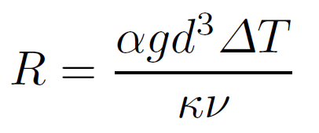
Rayleigh-Bénard Convection
Henri Bénard and Lord Raleigh
Convection in a shallow horizontal layer of a fluid heated from below
Instability at R = 1708
g = acceleration of gravity
ΔT = temperature difference
d = spacing between plates
α = thermal expansion coefficient
κ = thermal diffusivity
ν = viscosity
1. Ahlers, G .(2006) Experiments with Rayleigh-Bénard Convection. In Mutabazi, I., Wesfreid, J. &, Guyon, E., In Dynamics of Spatio-Temporal Cellular Structures (67-94) Springer Berlin / Heidelberg

Slide 4
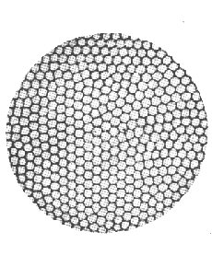
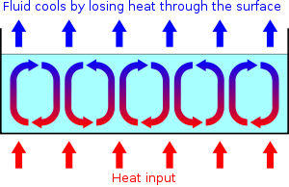
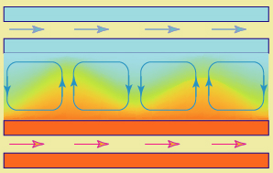
Rayleigh-Bénard Convection
3
2
1
Rayleigh-Bénard convection. (2012). Rayleigh-Bénard convection. Retrieved April 11, 2012 from http://www.enotes.com/topic/Rayleigh-B%C3%A9nard_convection
Rayleigh-Bénard Instabilities in Nematics. Rayleigh-Bénard convection. Retrieved April 11,2012 from http://www.lps.u-psud.fr/Collectif/gr_15/R_B_Inst_LC.htm
Viva La Evolucion!. (2006). Rayleigh Benard Convection. Retrieved April 11 ,2012 , from http://vivalaevolucion.blogs.ie/2006/01/

Slide 5
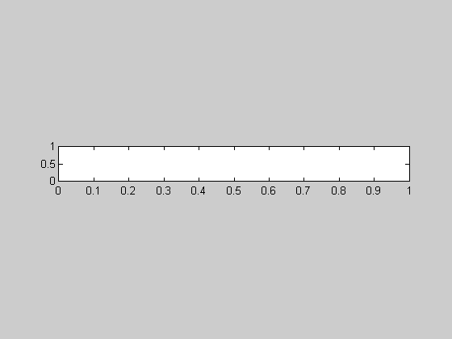
Results
Rayleigh Number = 500

Slide 6
Results
Rayleigh Number = 1708

Slide 7
Results
Rayleigh Number = 7000

Slide 8
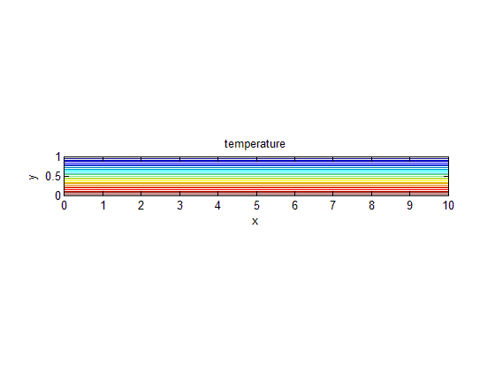
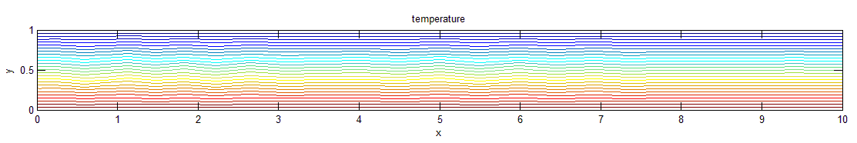
Results
Rayleigh Number = 500
Rayleigh Number = 1708
Rayleigh Number = 7000

Slide 9
Future Work and Further Applications
Investigate different convection phenomena
Investigate effects of thermal diffusivity, thermal coefficient, viscosity on convection phenomena
Use this method to solve other equations, e.g. double diffusive convection

Slide 10
Thank You
Arizona/NASA Space Grant Consortium
University of Arizona
Dr. Cho Lik Chan
Eric Wilder

Slide 11
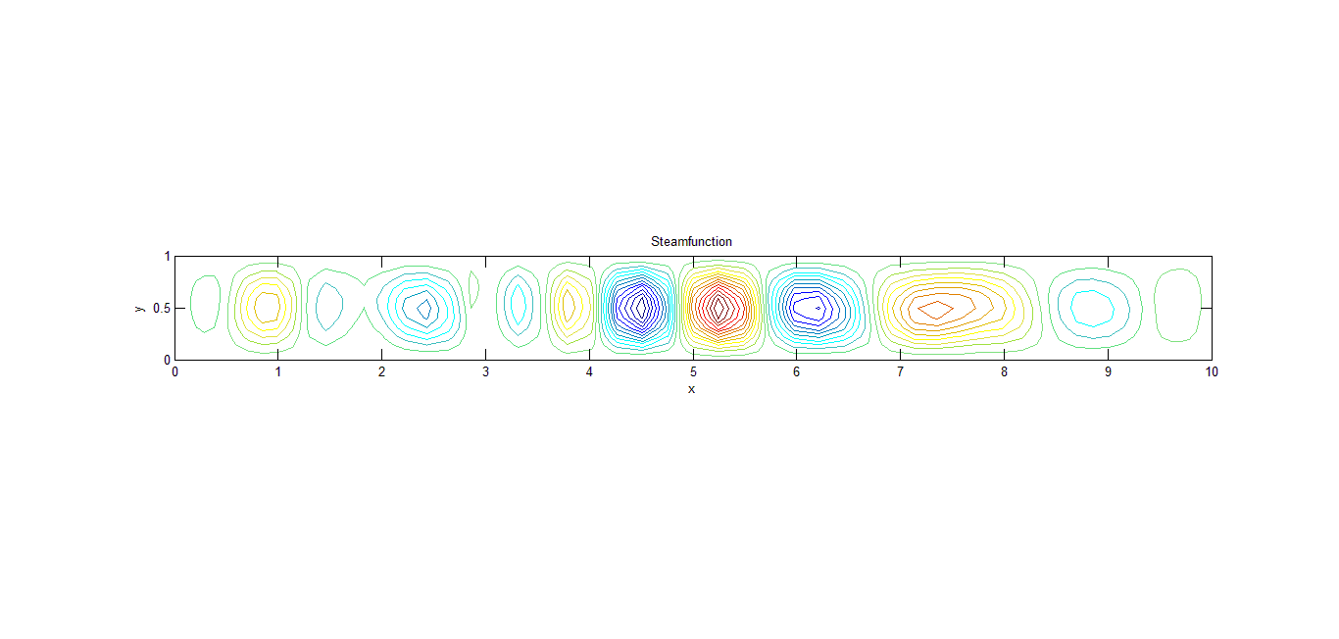
Results
Rayleigh Number = 500

Slide 12
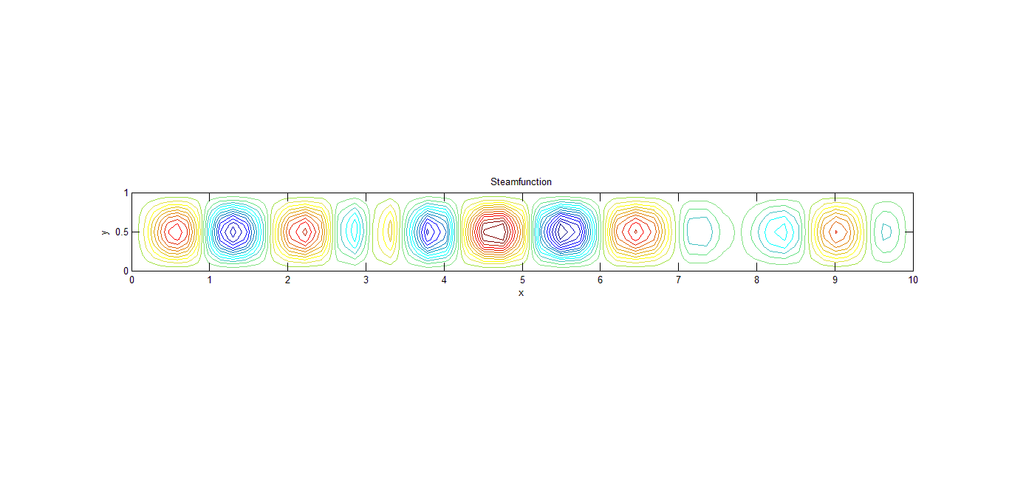
Results
Rayleigh Number = 1708

Slide 13
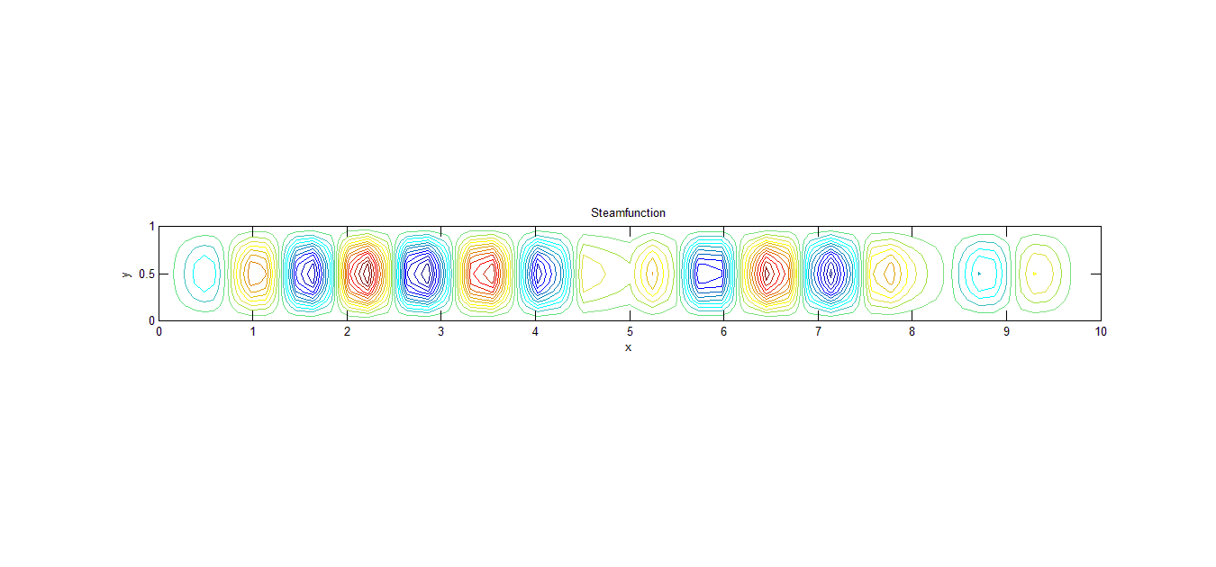
Results
Rayleigh Number = 7000

